Slide 1
Interpretation of EROS Microlensing Data toward Spiral Arms
Sohrab Rahvar
Sharif University of Technology
Marc Moniez
LAL-CNRS

Slide 2
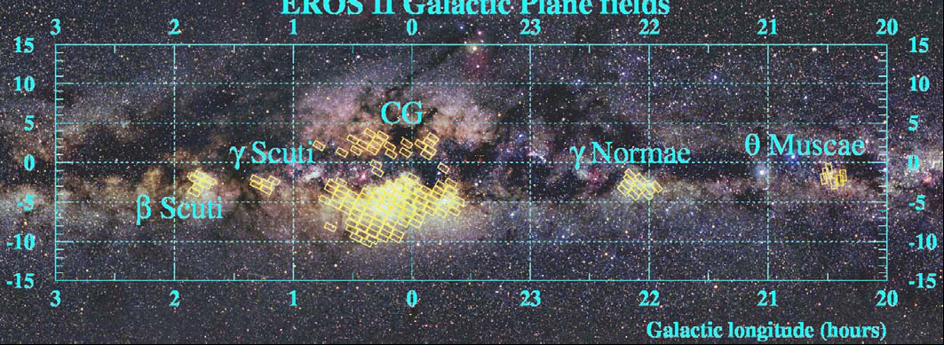
EROS Seven Season Result (arXiv:0901.1325 ) :
12.9 Million stars monitored in 4 directions of spiral arms
27 microlensing candidates
τ estimated from the 22 best events (u0<0.7)
Distance distribution of source stars wide and poorly known
-> Catalog optical depth
EROS catalog almost complete for
-> Corresponding optical depth

Slide 3
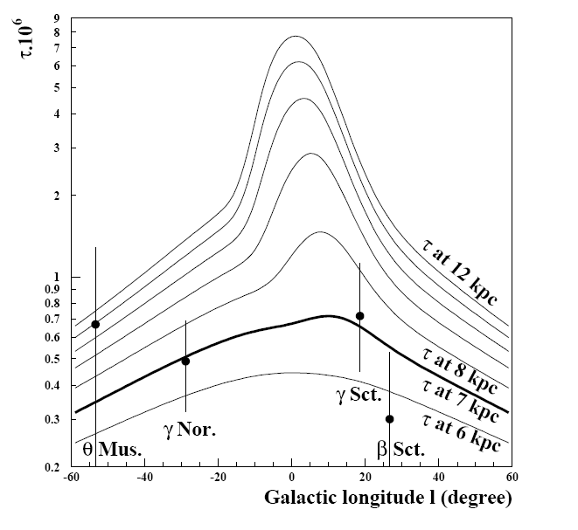
Optical Depth assuming source at a given distance from the observer

Slide 4
Procedure
Model (bar parameters, dust…)
Synthetic Observation (CM diagram, optical depth, tE distribution)
Comparison with EROS observations
Fit model parameters
EROS efficiencies

Slide 5
Model
Double Exponential model for disk plus bar with bar-inclination and dust abundance to be fitted.
Chabrier (2004) IMF
Hipparcos data to determine the local CM diagram.
Extinction model

Slide 6


Galactic Model (1)
Disk Model
Bulge Model

Slide 7


Galactic Model (2)
Light absorption proportional to H column density
will be fitted.
φ could be fitted.
φ

Slide 8
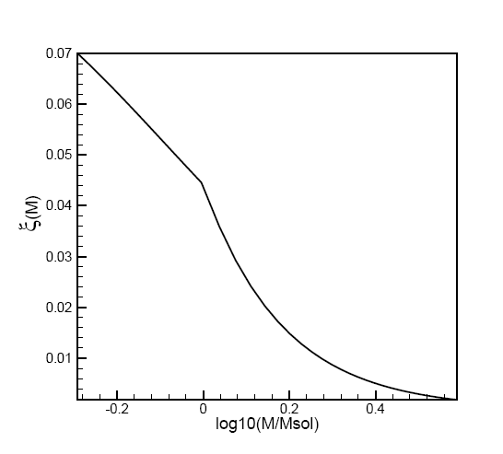
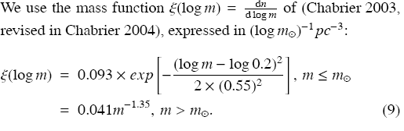
Stellar Mass function

Slide 9
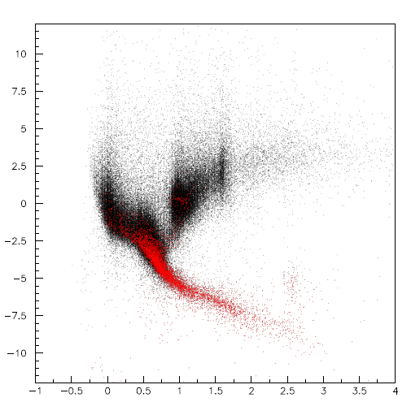
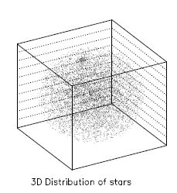
Hipparcos Data ~ 120,000 star
Hipparcos CM diagram
red = stars <50 pc
Isotropy of stars within 50 pc
Hyades
open cluster

Slide 10
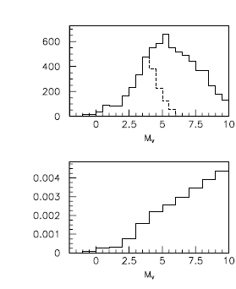


Debiased local CM distribution
Hipparcos stars within < 50 pc
Distribution of stars in Hipparcos complete until mv<7.5
Distribution after debiasing and extrapolation.
Color extrapolated from the color vs mag relation for faint stars:
Hipparcos complete until 50 pc
Hipparcos complete until d(completion)
Not enough faint stars around sun
Debiased local density of stars
Debiasing
Extrapolation

Slide 11
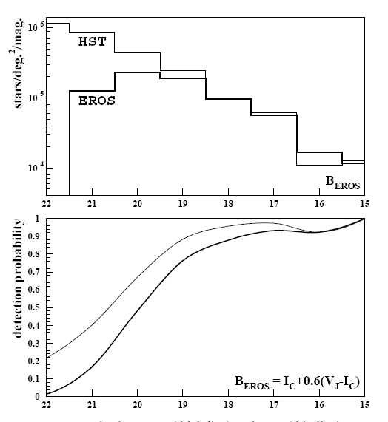
Star Detection Efficiency
From the local CM diagram to the EROS observed catalog
Detection efficiency of EROS as a function of B(EROS) from HST images

Slide 12
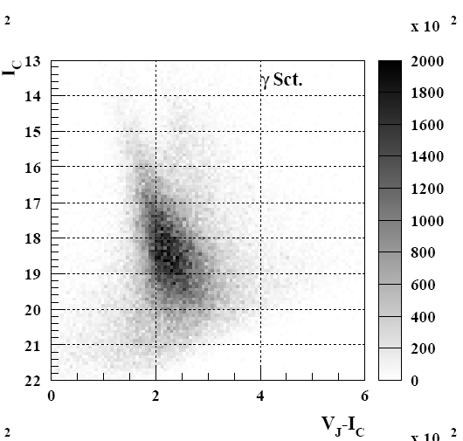
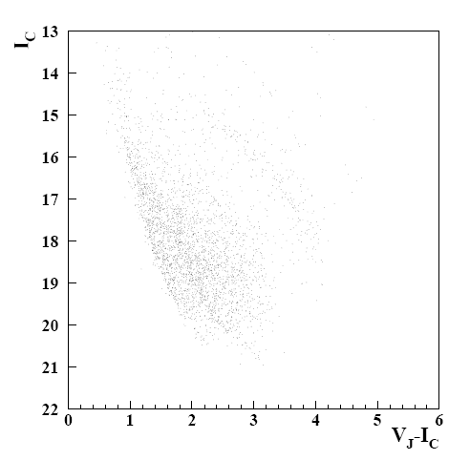
Synthesized CMD toward γ sct
EROS catalog
Synthetic Catalog

Slide 13
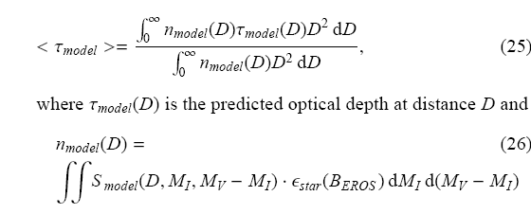


Optical Depth predictions
Integrated along the line of sight & averaged on EROS catalog (Catalog optical depth)
Smodel is the simulated stellar density

Slide 14
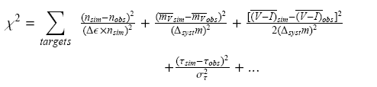
Fitting model with EROS data
Expresses the difference between the model and the observations
Here we choose to fit and we found the best agreement
between data and model with f ~ 6 % (to be finalized)

Slide 15
Perspectives
- Consider simulated and observed mag and color distributions (not only average values) in the fit
- Also consider simulated and observed tE distributions
- Use absorption maps (Besancon model)
- Include observations towards Galactic center

